Slide 1
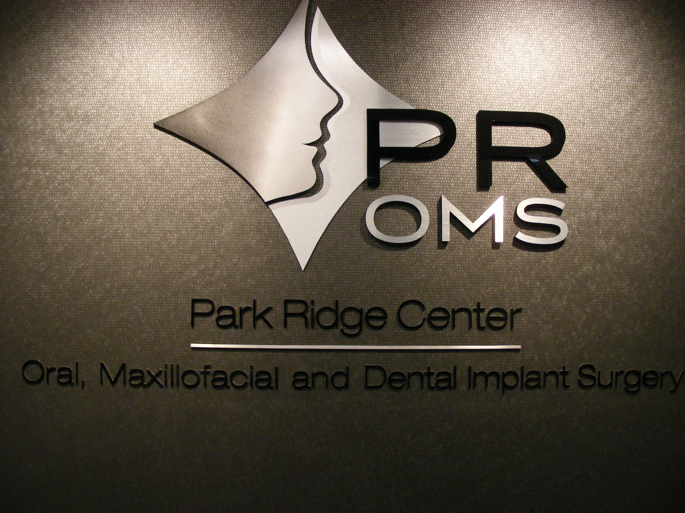

Slide 2
VIRTUAL IMPLANT SURGERY

Slide 3
CT GUIDED SURGERY
Medical grade CT Scan or Cone Beam CT dicom file reformatted to implant placement software
Simplant
NobelGuide
Easy Guide
Anantomage

Slide 4
VIRTUAL IMPLANT SURGERY
Ability to place restorative driven implants
Place implant in best position in bone
Avoid vital structures
Avoid bone perforations
Lessen surgery time

Slide 5
Medical grade CT scan is no longer considered as a safe dose of radiation for the planning of dental implant cases.
The radiation dose of a medical grade CT versus a Cone Beam Ct Scan can be as much as 1000 times more radiation.

Slide 6
The following are cases that were referred to our office with problems that occurred with their implant surgery

Slide 7
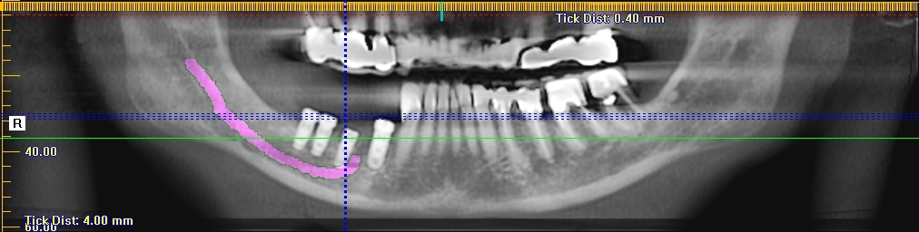
Implants placed without guide

Slide 8
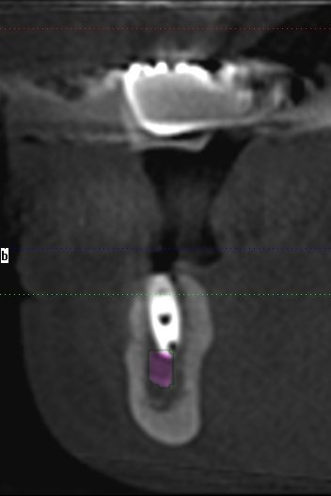
Implant into nerve
Cross section of previous slide

Slide 9
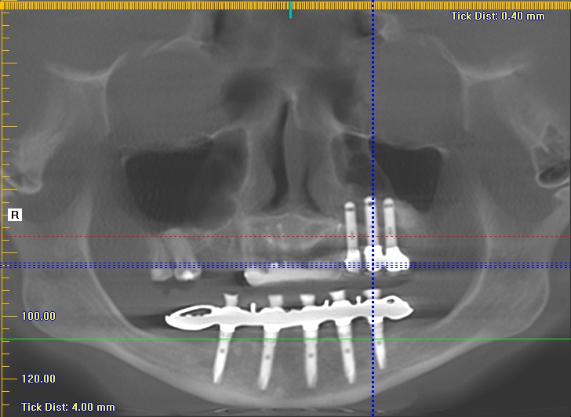
Placement appears to be good in maxilla on Panorex

Slide 10
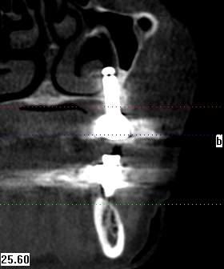
Cross section shows implant in nasal cavity No guide used

Slide 11
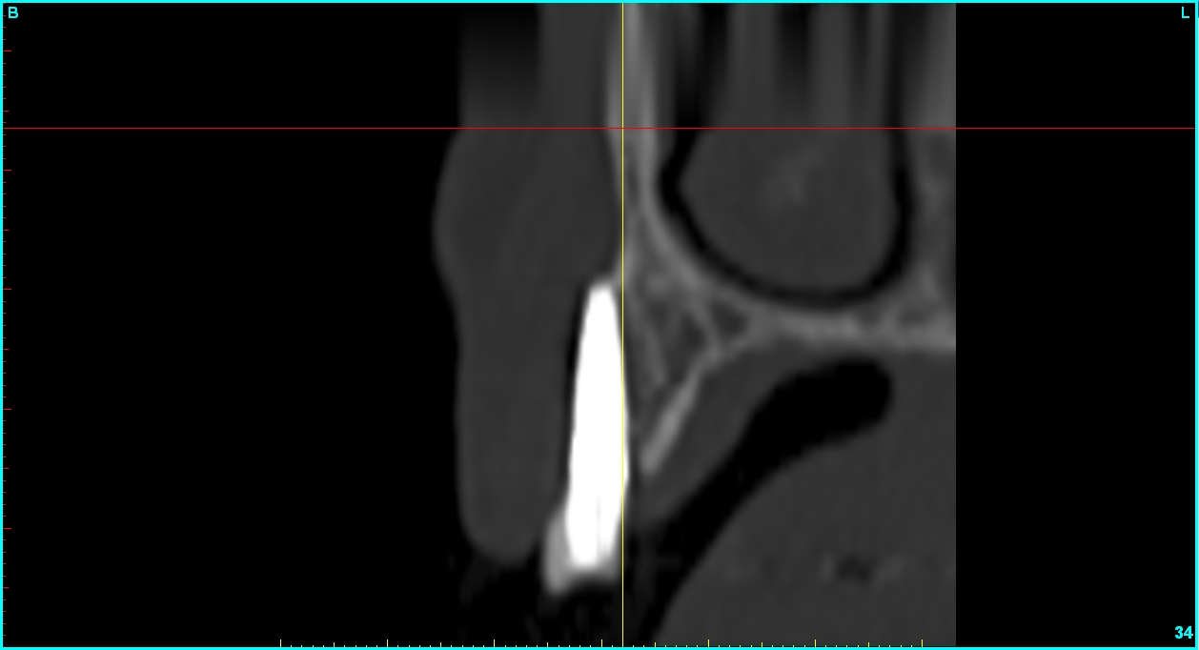
Implant placed outside of bone

Slide 12
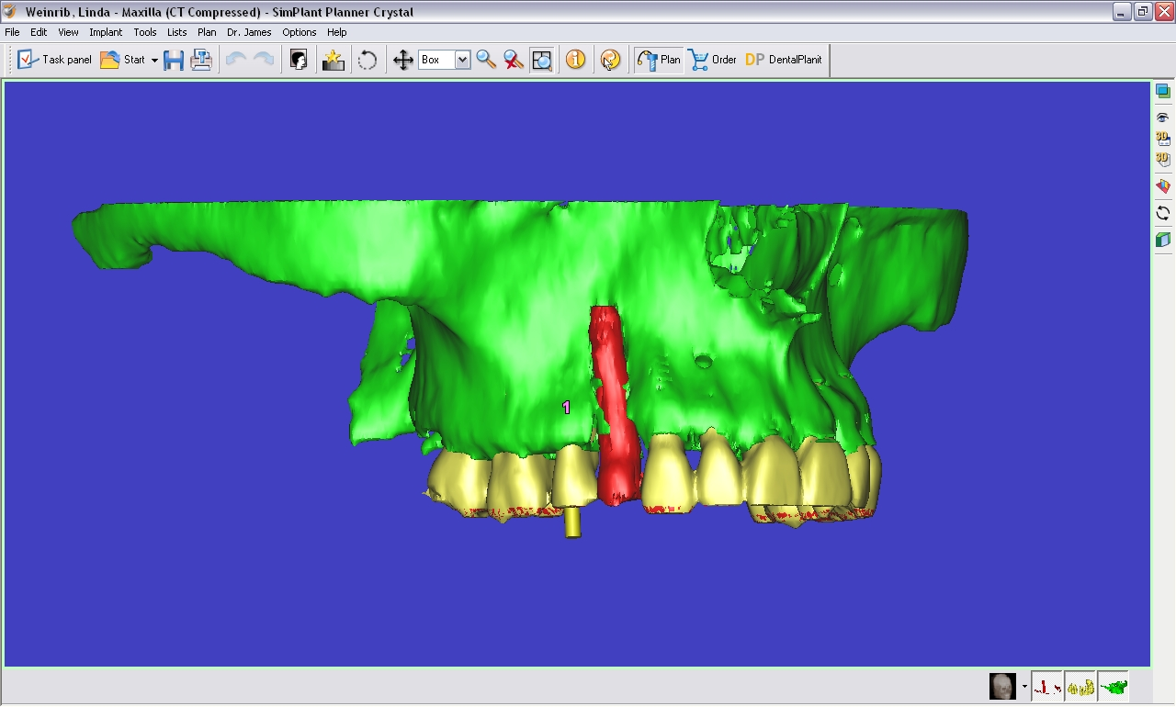
3-D Reconstruction

Slide 13
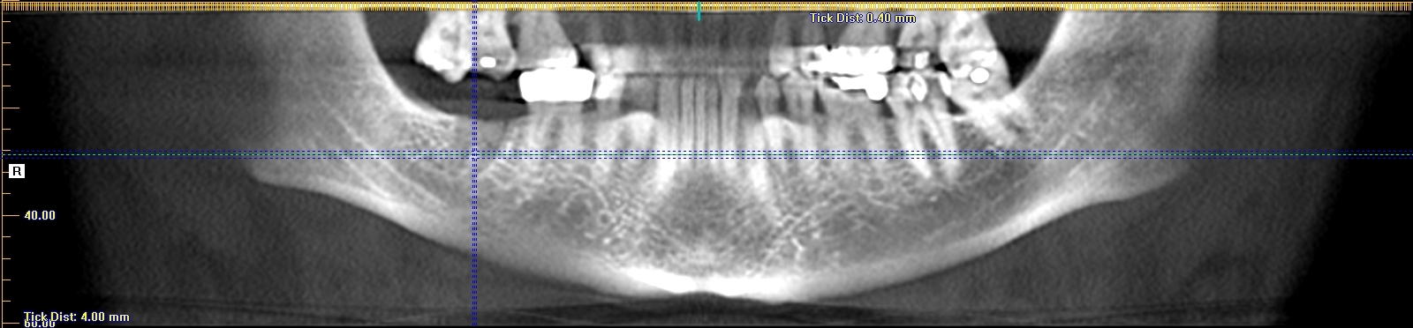
Panoramic view showing good bone above nerve

Slide 14
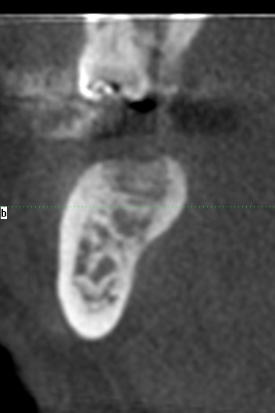
Cross section reveals anatomic concavity and possible perforation if implant placed in wrong direction

Slide 15
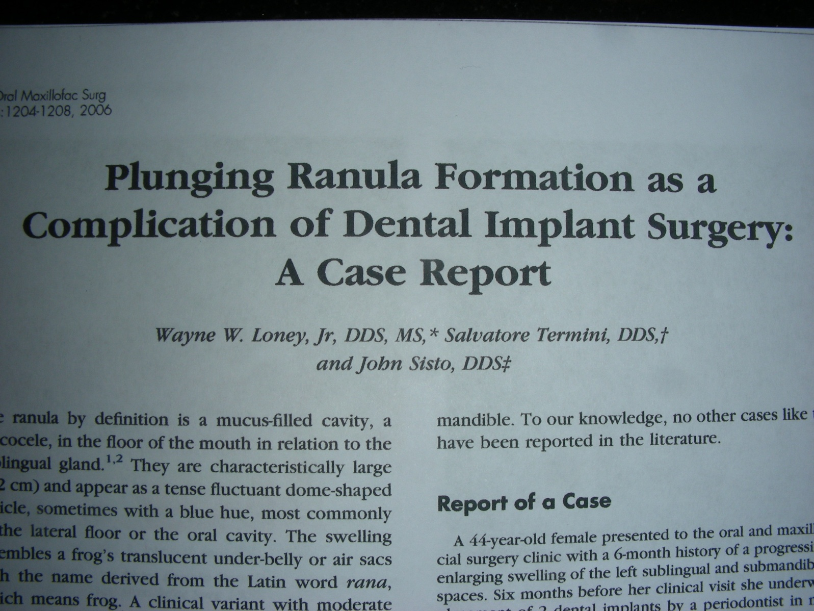
Article I co-authored describing result of misguided implant placement

Slide 16
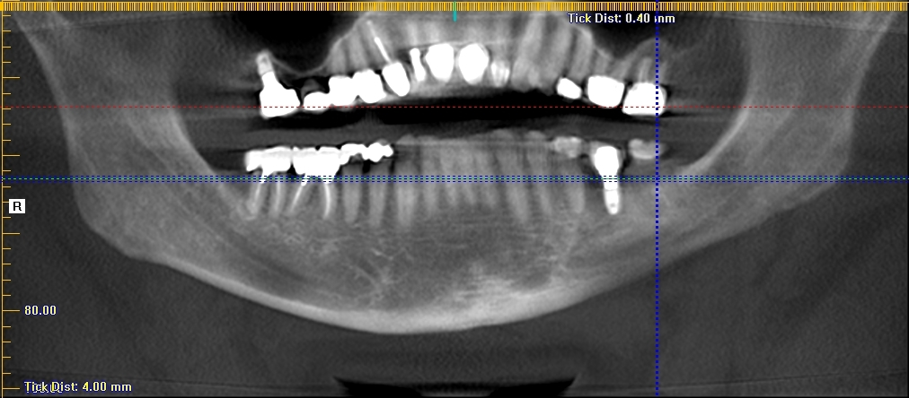
Implant looks good on panoramic view

Slide 17
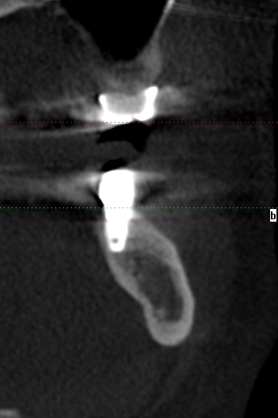
Cross section shows poor placement

Slide 18
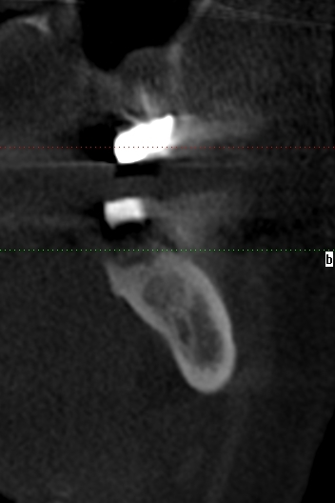
Difficult anatomy

Slide 19
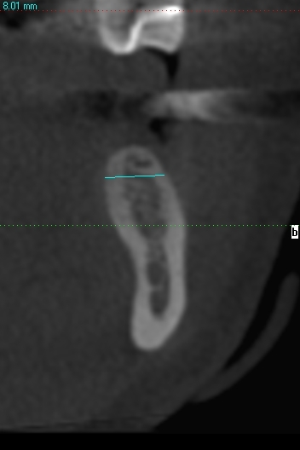
Narrow bone: little room for error. Implant I placed with Virtual surgery guide

Slide 20
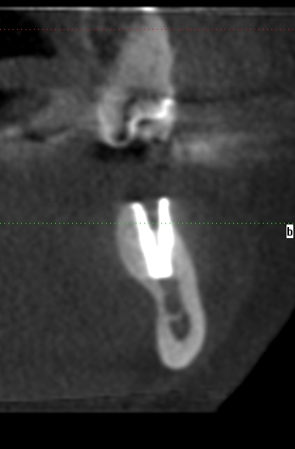
Result of previous slide with guided surgery

Slide 21
Maxillary Full Arch Case with Immediate Restoration: Simplant Work-up
TEETH - IN – A - DAY

Slide 22
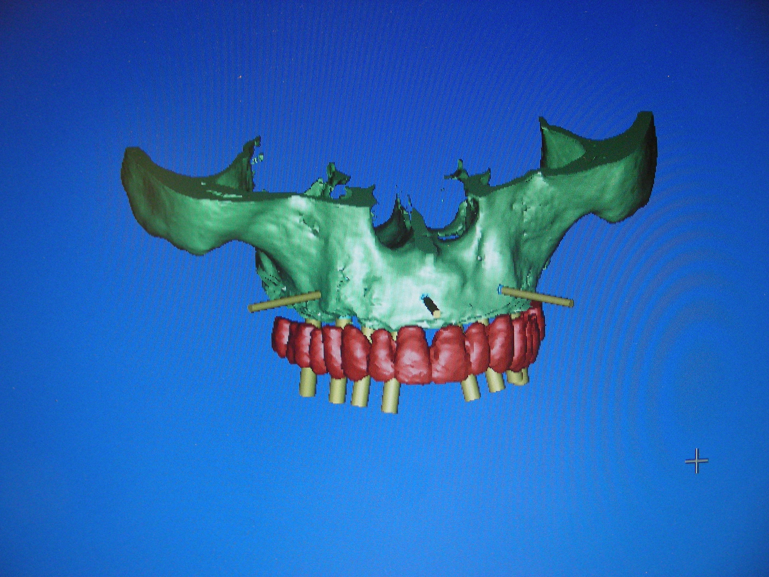

Slide 23
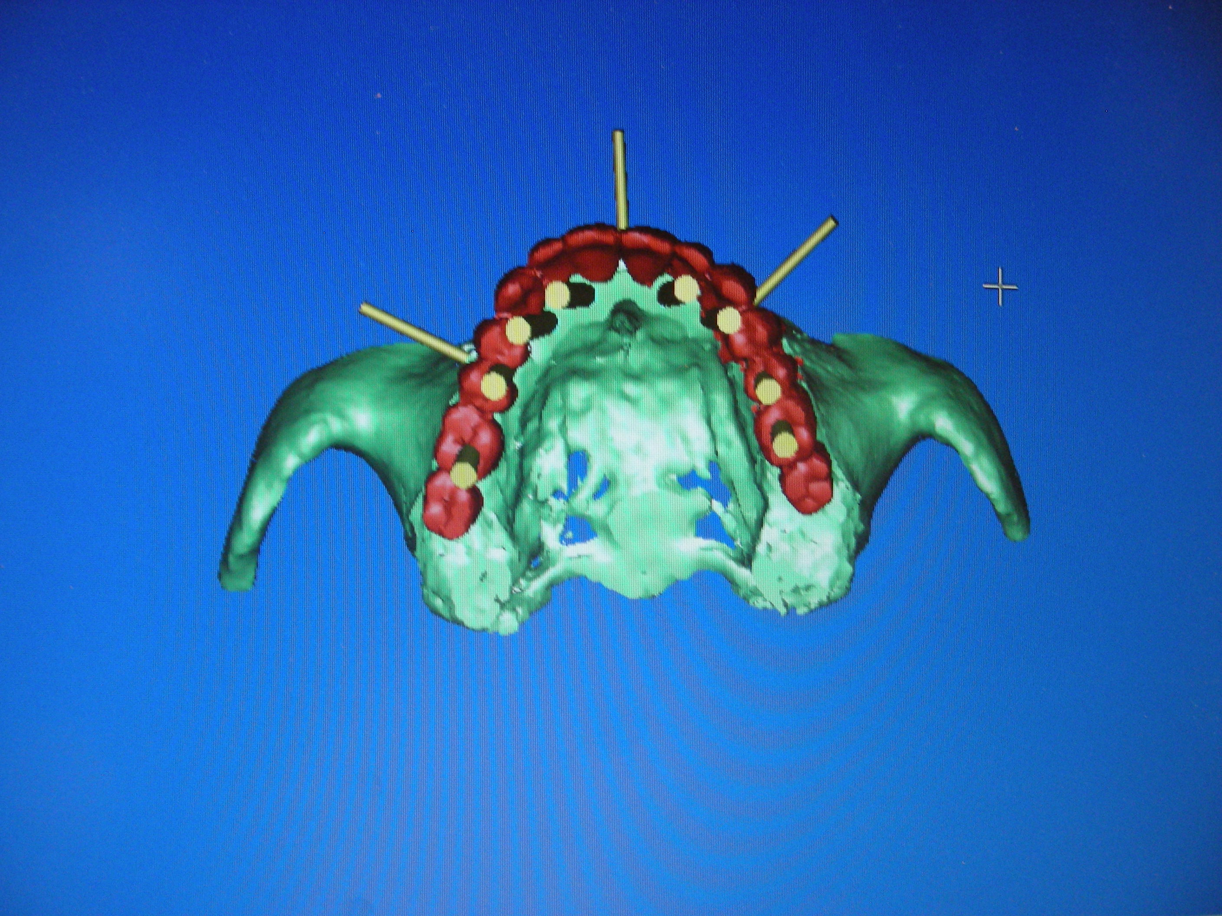

Slide 24
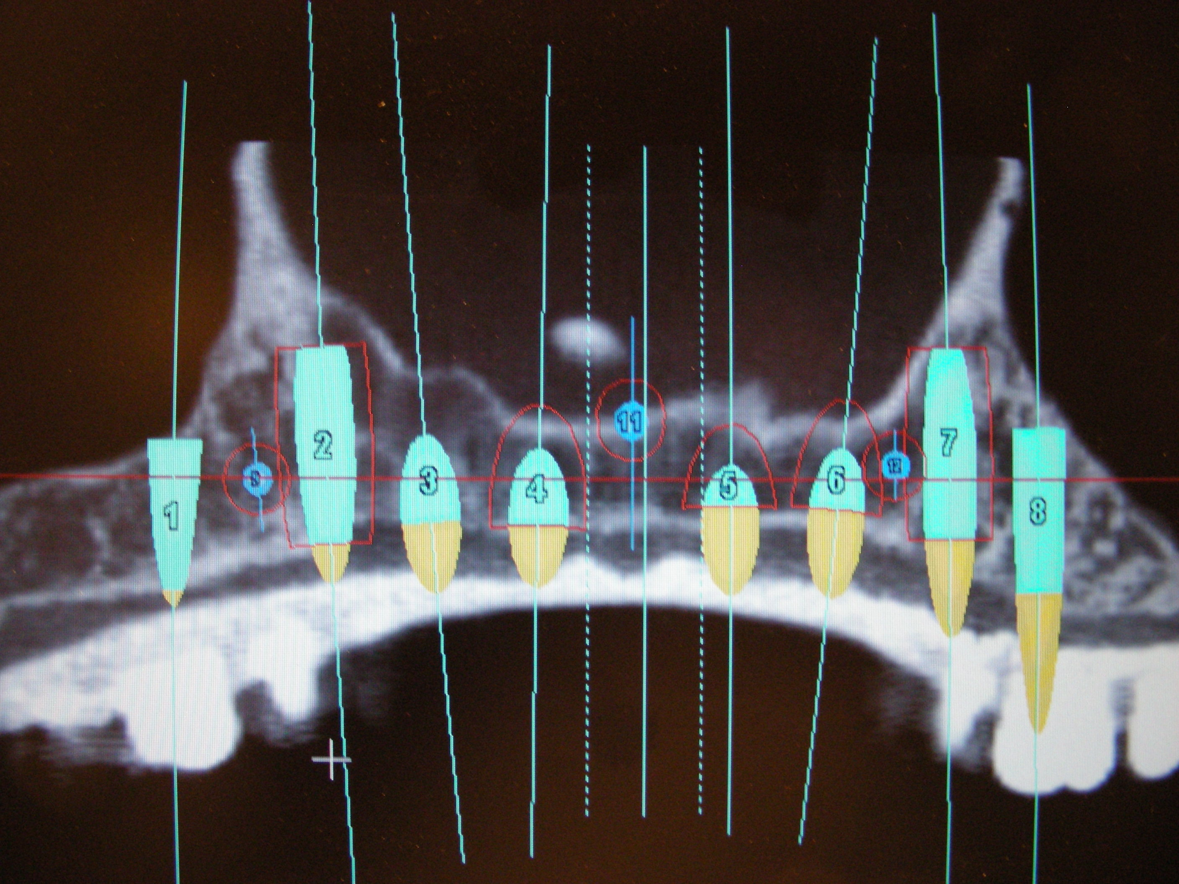

Slide 25
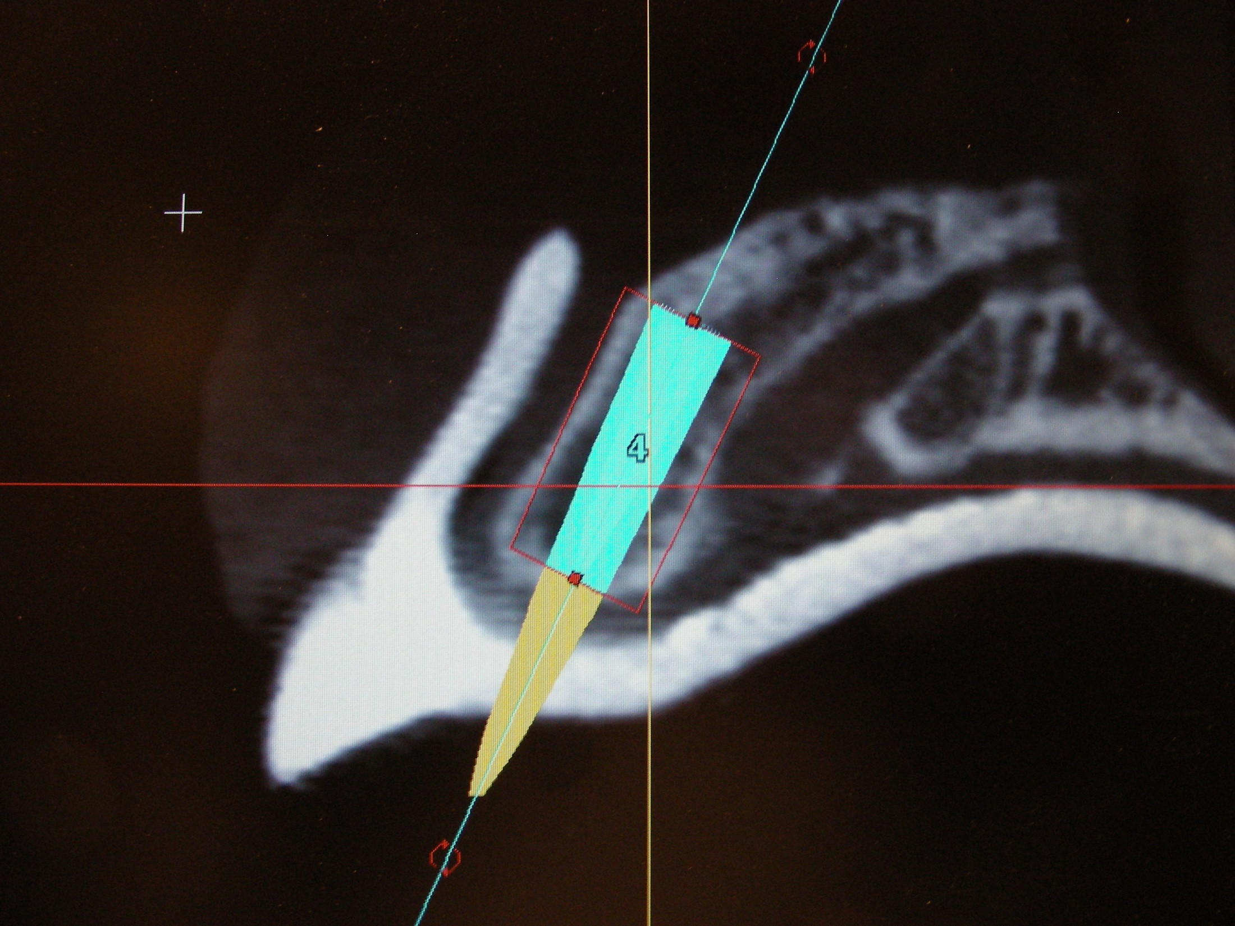

Slide 26
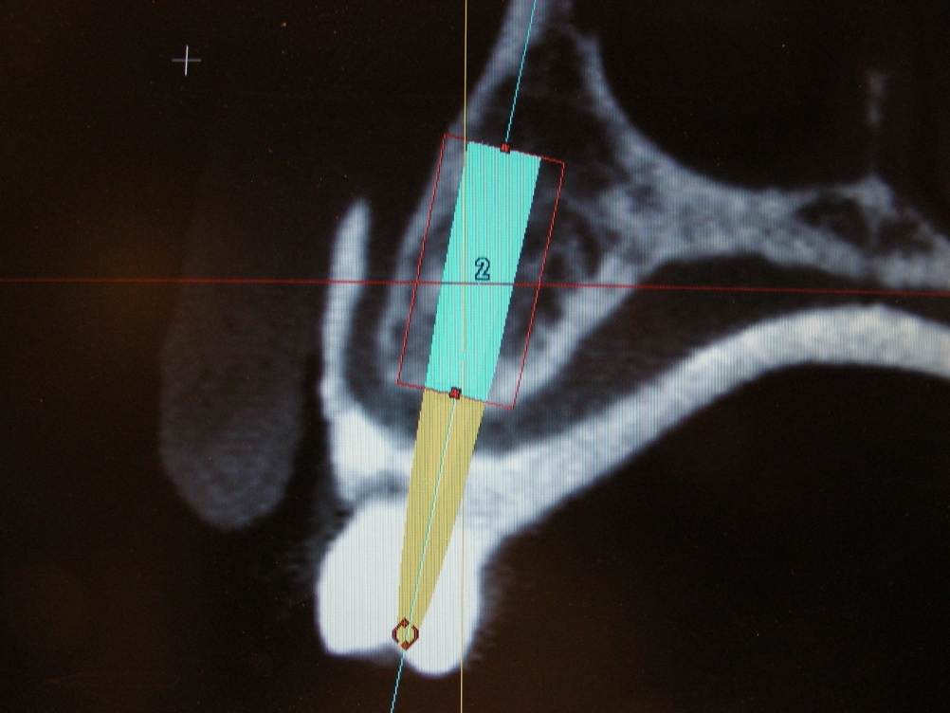

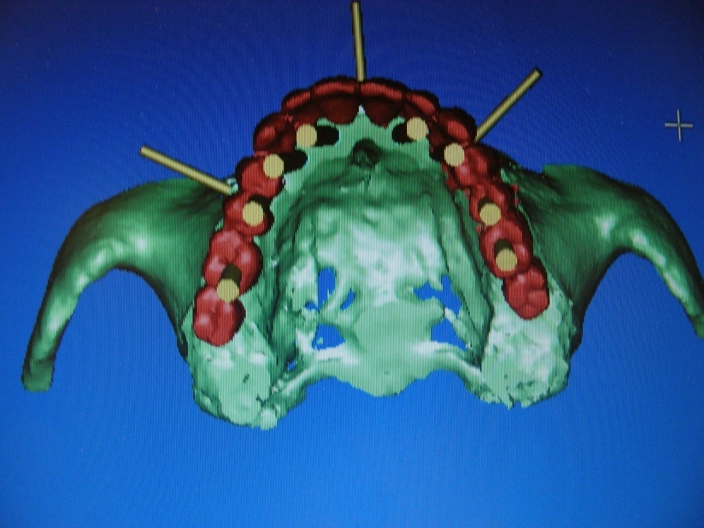

Slide 27
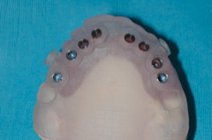
Surgical Guide Stent

Slide 28
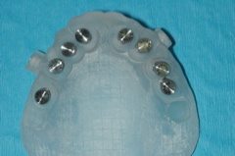

Slide 29
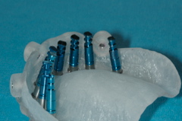

Slide 30
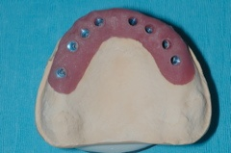

Slide 31
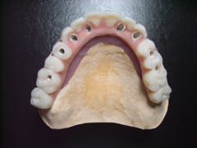
Prefabricated immediate bridge

Slide 32
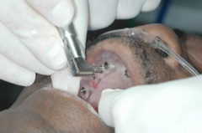

Slide 33
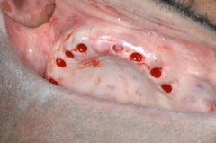

Slide 34
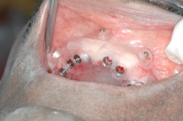

Slide 35
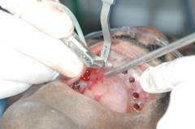

Slide 36
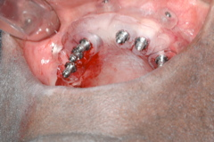

Slide 37
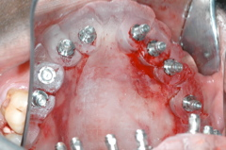

Slide 38
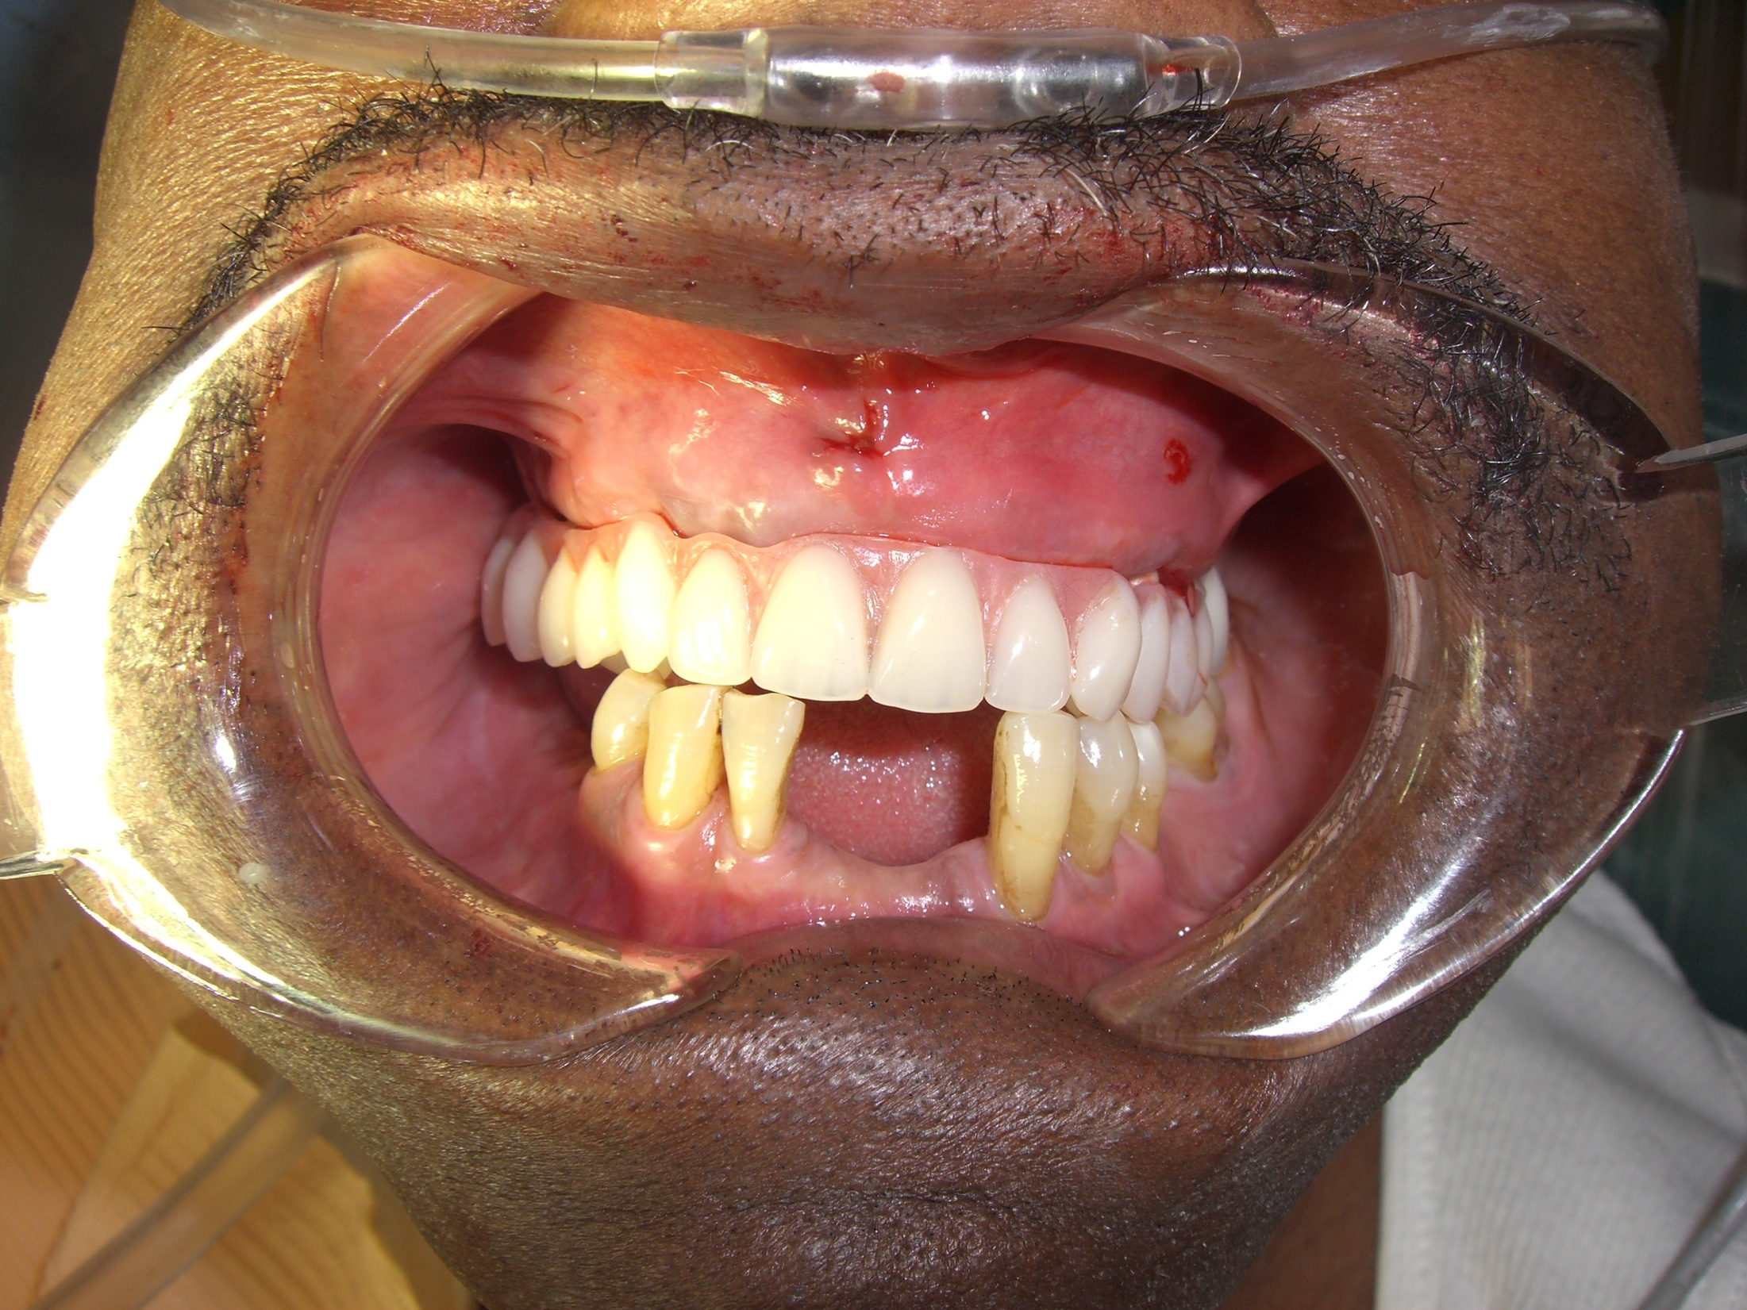

Slide 39
SIMPLANT SOFTWARE
Extractions with immediate implant placement
Delayed restoration with milled bar and locator attachements

Slide 40
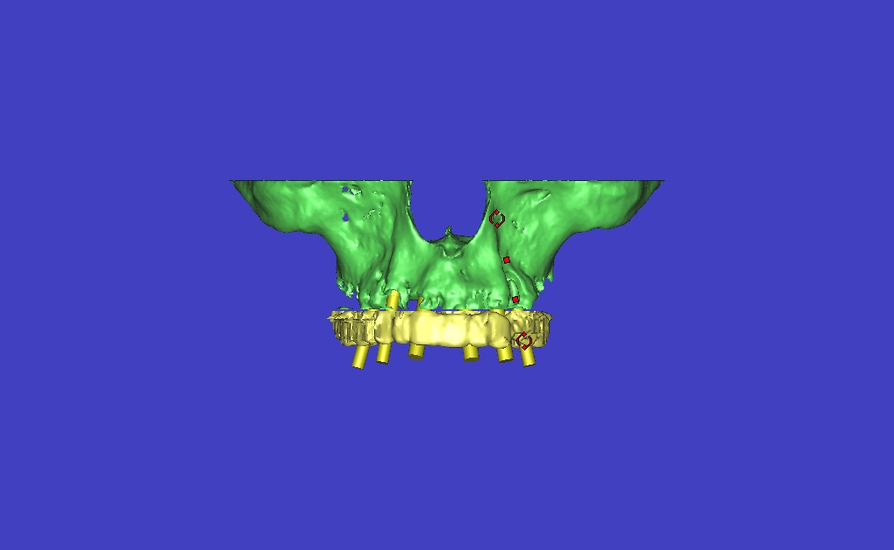

Slide 41
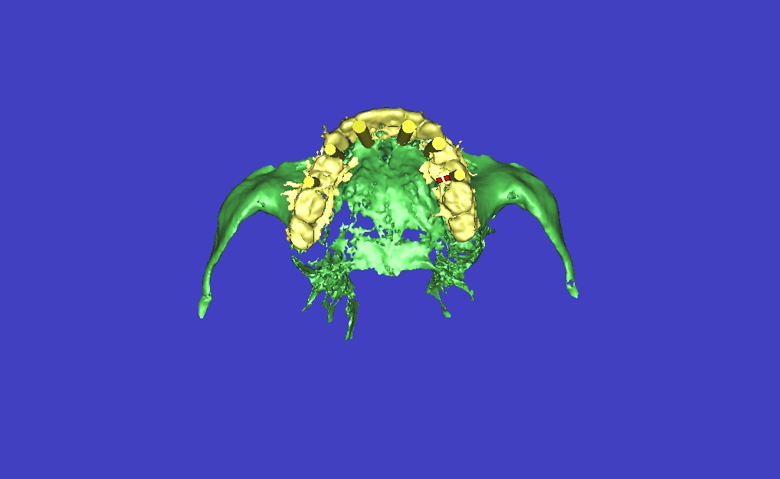

Slide 42
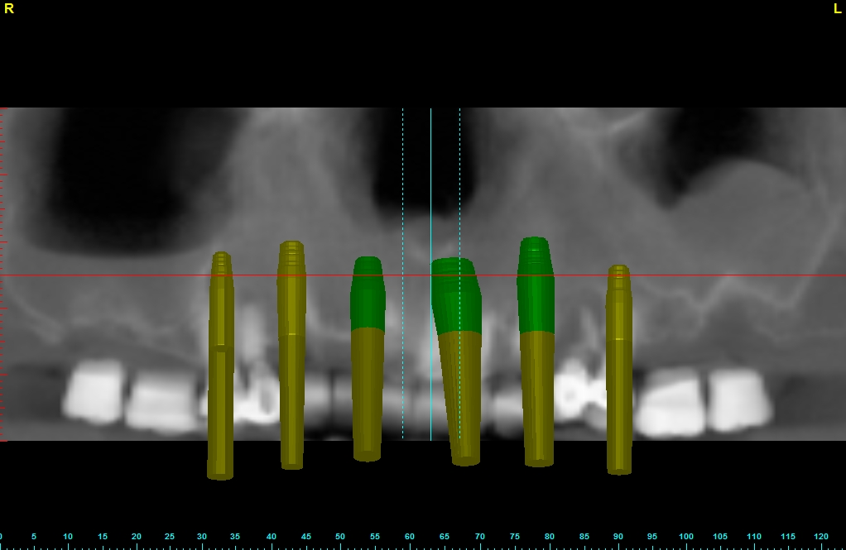

Slide 43
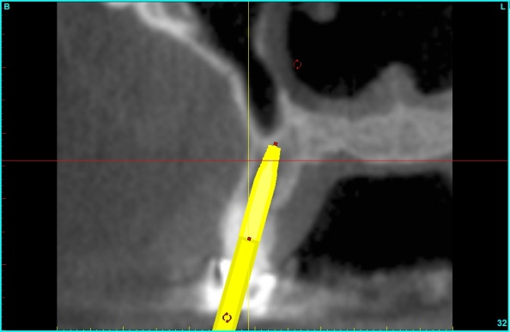
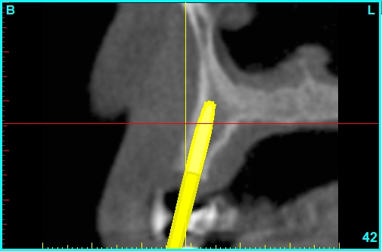
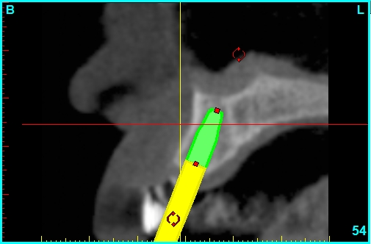

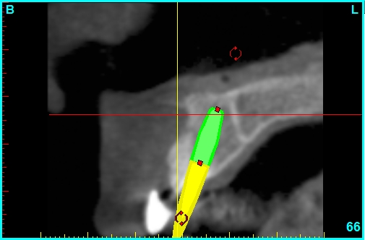
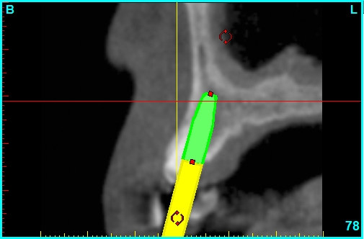
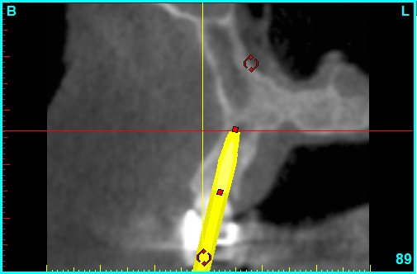

Slide 44
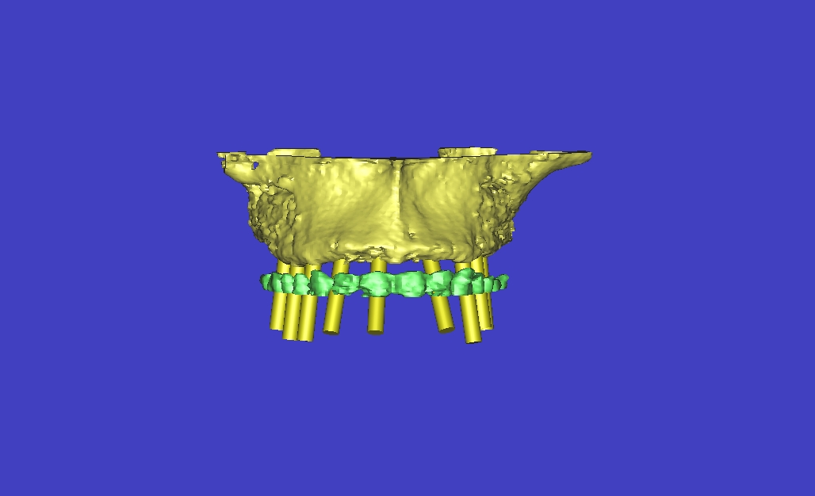

Slide 45
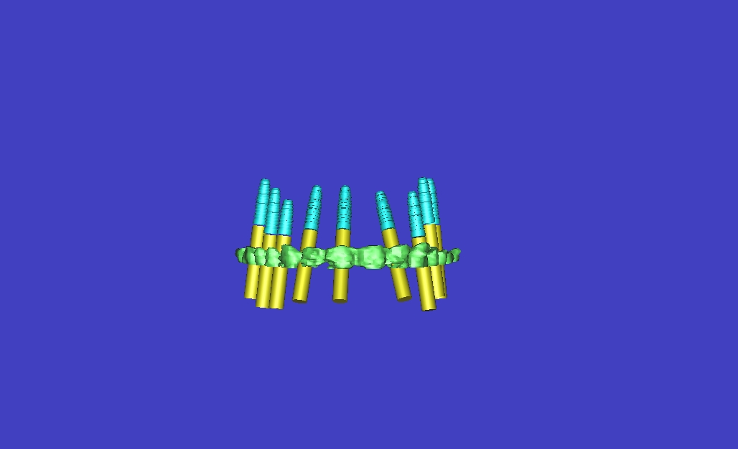
Subtraction Feature of Software

Slide 46
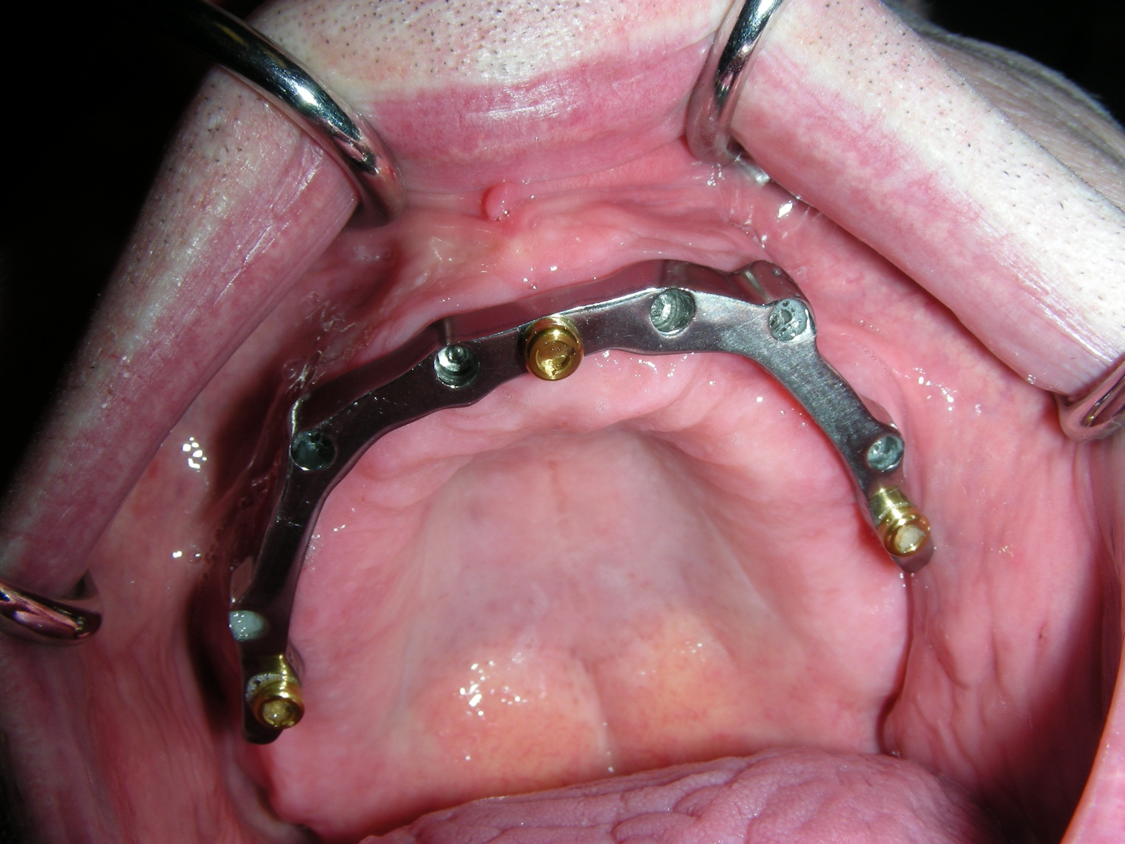

Slide 47
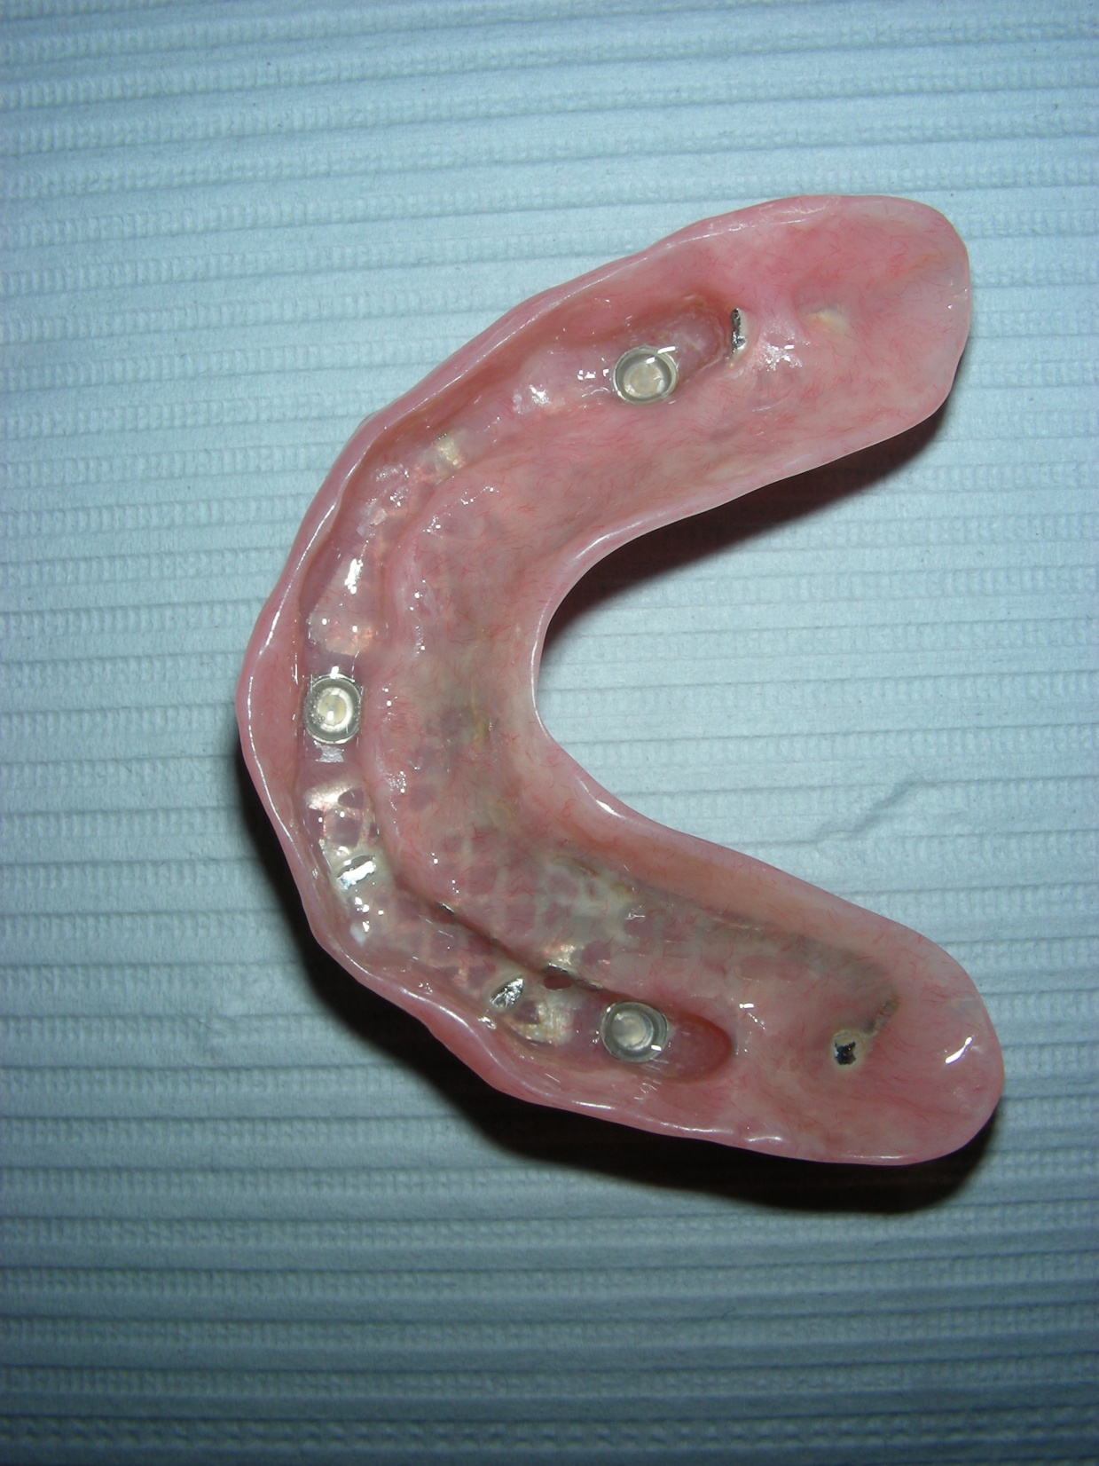

Slide 48
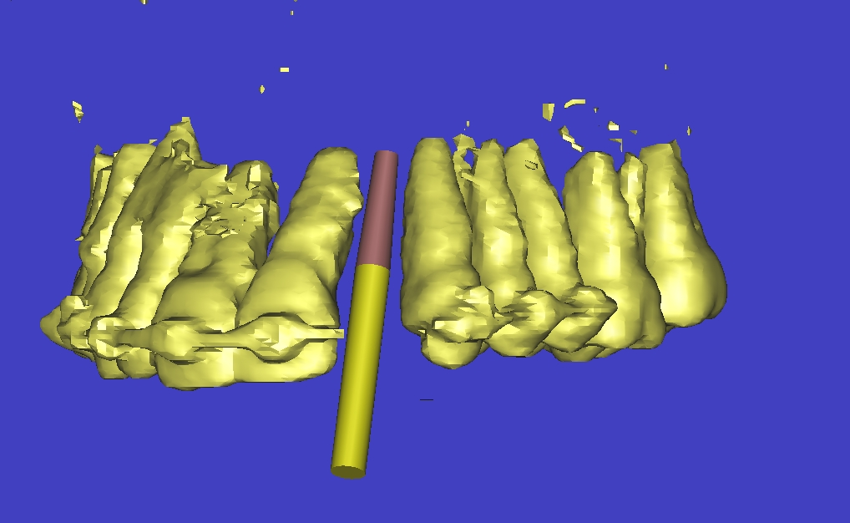
Extremely small space

Slide 49
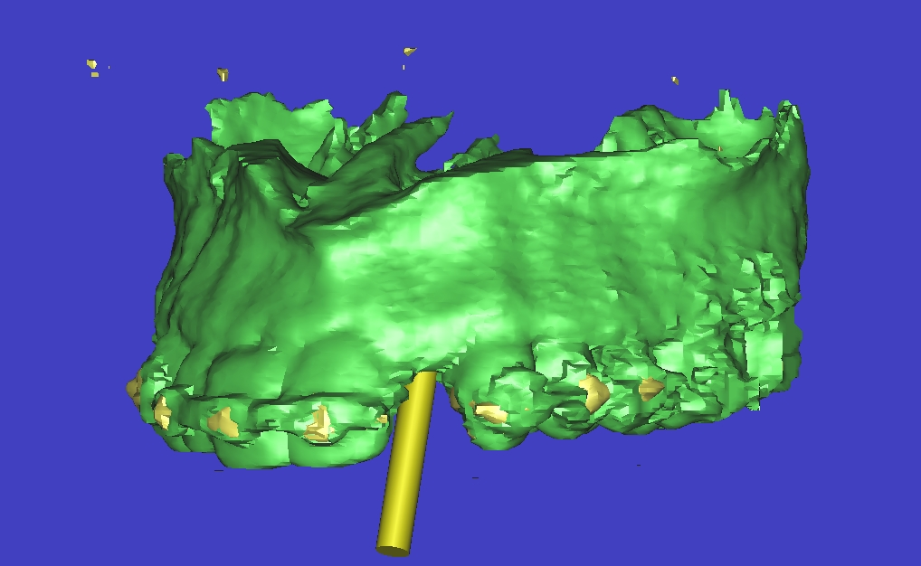

Slide 50
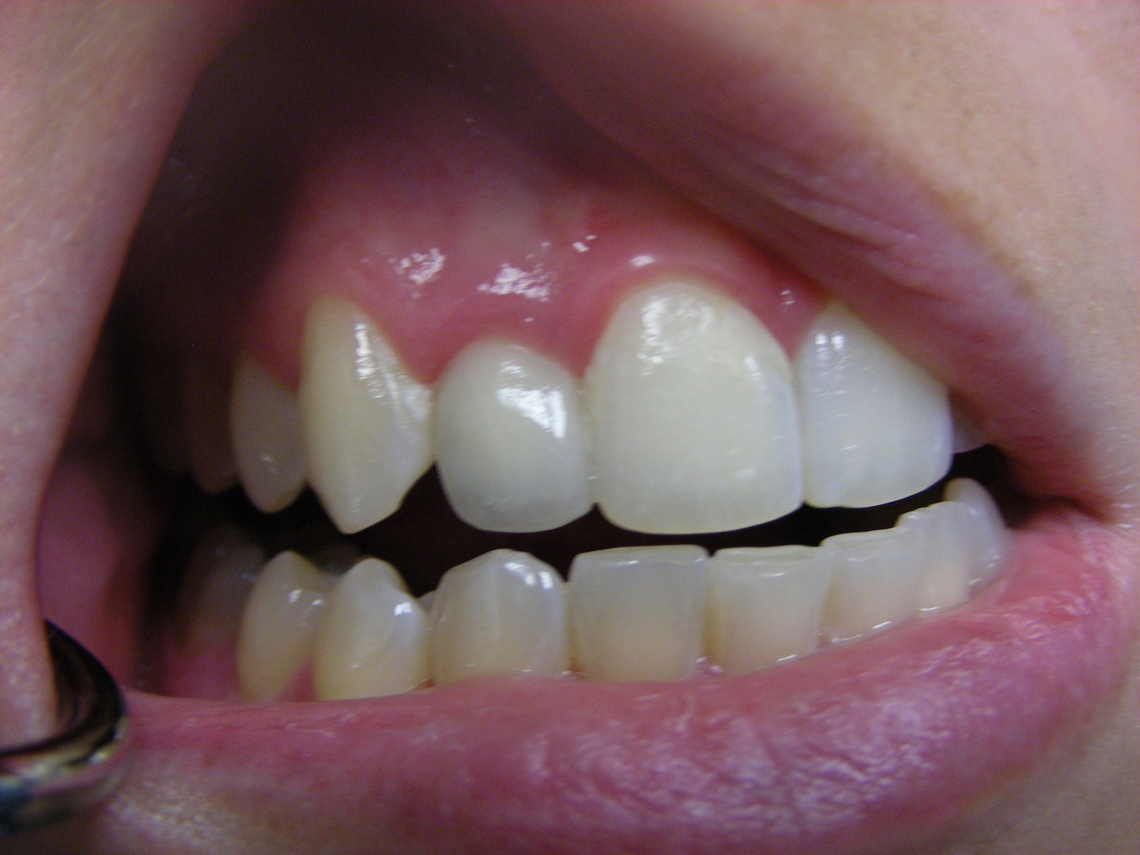

Slide 51
ESTHETIC CASE WITH SIMPLANT WORK UP

Slide 52
